Slide 1
HOW TO SUMBIT YOUR TIMS CERTIFICATION

Slide 2
TIPS BEFORE YOU BEGIN
Use Internet Explorer or Microsoft Edge for best results!
Go to https://www.mypdeapps.pa.gov/wfTIMS.aspx
Ready?? Let’s go…

Slide 3
Log Into www.education.pa.gov
https://www.mypdeapps.pa.gov/wfTIMS.aspx
First time users; select “Register Username”
Complete the REGISTER form – select the Register box. You will receive a Registration Complete message – Select Continue
Go back to the MyPDESuite Application Login Screen
Log in using the username and password you just created.
Step by step guide can be found here: https://www.education.pa.gov/Educators/Certification/Application/UserGuides/Pages/TIMSPersonal.aspx
Returning users; log in

Slide 4
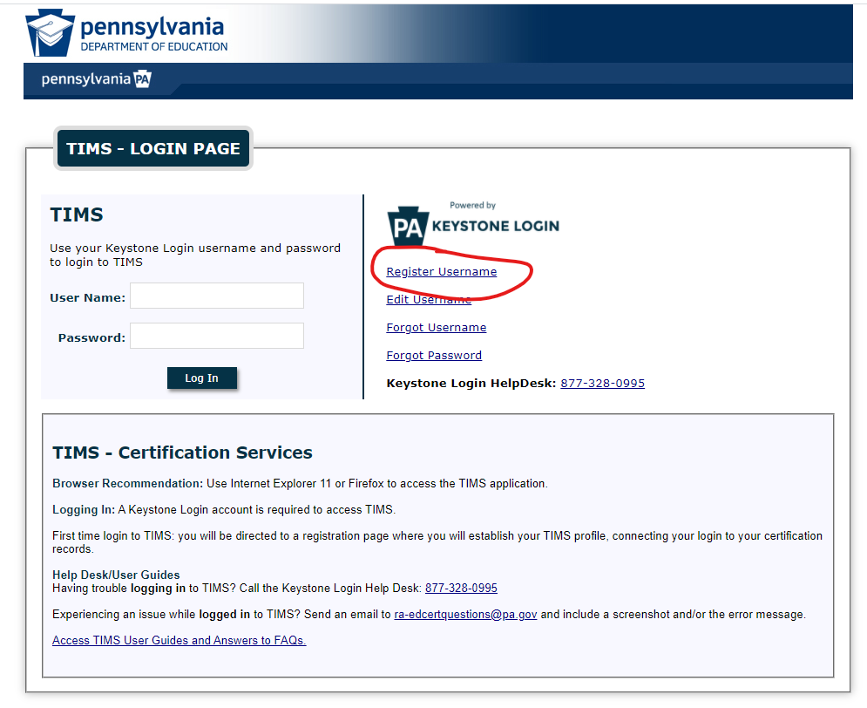
Example: TIMS Log in Screen
Red Circle is the link to click if you are a first time user

Slide 5
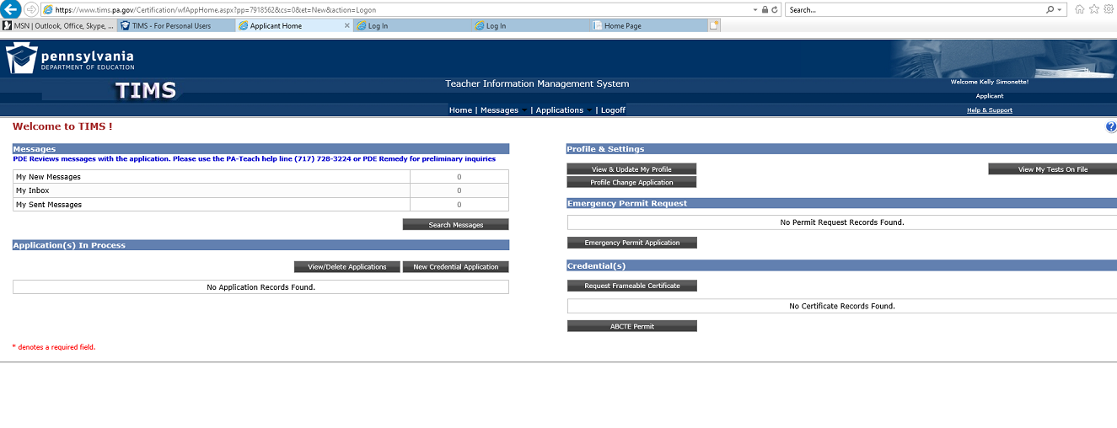
TIMS Home Page
Go to NEW CREDENTIAL APPLICATION

Slide 6
TIMS – New Credential Application
Select Certification Type – Use the pull-down field to select certification type. Most will be Instruction 1 (61).
Select Subject Area – Use pulldown and choose your subject area (s). Dual Majors should add both subject areas here before saving (dual majors are required to apply for both certifications concurrently)
NOTE: SPED – Do NOT Select Special Education EXPANSION. Use Special Education PK-8 (9226) or Special Education 7-12 (9227). Do NOT SAVE until you complete the rest of the form.
Answer the rest of the questions to continue >> SAVE.
You should see: “ Your application requires a response to the following preliminary question(s)”
> Are you applying to add an additional subject area to an existing Instructional I Credential through testing alone? ANSWER: NO
> Will a Pennsylvania institution verify that you meet certification requirements for the certification you are apply for? ANSWER: YES
Are you sure you want to proceed with this application: YES

Slide 7
Step 1 : Background Questions
Answer questions 1-7
Check Affidavit box
Select NEXT in upper right hand corner (to page 2)
Step 2: Demographic Details
Complete all information on page 2
Use your NON-PennWest email address as PDE may need to contact you regarding this application.
Select NEXT in upper right hand corner (to page 3)

Slide 8
Step 3: Education Details
Required Education
Click ADD NEW
Select Pennsylvania Western University
AUN Number 401637019
Contact Official Details
STEPHANIE WILLIAMS (Edinboro)
AMY SHOPE (California)
TIM STEVENSON (Clarion)
Did you receive any Degree while at this institution?
> YES
Degree: Select BACHELORS or MASTERS
Date Conferred (MM/YY)
GPA
Select Major Subject Area from Pulldown
Did you complete the PDE approved Educator Preparation Program(s) for this subject area at this institution?
> YES
Click here to add Educator Preparation Program
Your program should appear in the pulldown
Program Level – Undergraduate or Graduate
Program Level Type – Traditional
Add attendance start date MM/YYYY
Add anticipated Graduation date
MM/YYYY
Add Program GPA
Save
Click NEXT for page

Slide 9
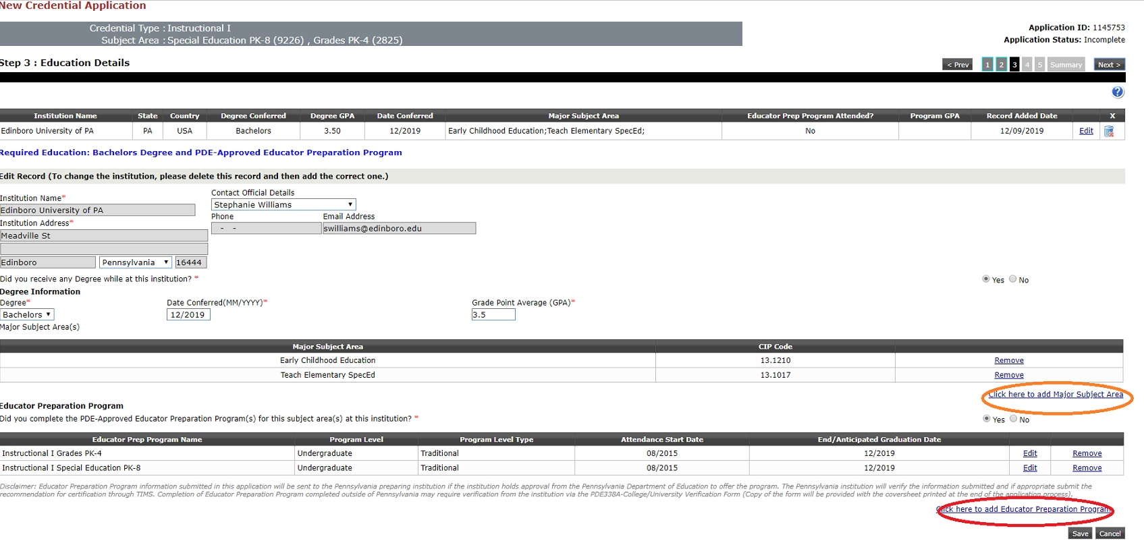

Slide 10
Step 4 : Certification Program Provider Survey
Complete all questions
Select NEXT for page 5
Step 5 : Certification Details
In State Certification -
You currently do not hold any Pennsylvania State Certifications.
Answer Yes or No
Out-of-State Certification -
Answer Yes or No (if YES, click to add certification info)
Select NEXT for Application Summary – Review Carefully

Slide 11
TIMS – Application Summary
FEES & PAYMENTS
$200 unless military affiliated
Complete CODE of CONDUCT questions.
Print application for your records.
Proceed to submit >>
Payment Processing and Application/Request Submission
Select Credit Card
Proceed to Payment Vendor Page
Click OK to be redirected to secure card payment site.
Do not hit back or you will have to contact customer support which is a very long wait.
Once payment is complete, you will be returned to TIMS. If an application cover sheet is required, you will have the opportunity to print it. You do NOT have to submit any test scores to PDE. If they want anything else, submit it or check with your campus Office of Clinical Experiences.

Slide 12
BEFORE YOU GO….
Do not submit your TIMS application until all testing requirements are complete!
Please submit your completed TIMS Credential Application . Your TIMS application will not be processed without it.
NOTE – To avoid delays in processing, notate the following on your credential application
If you are using your GPA to pass a PRAXIS II/PECT exam - tell us which exams and module(s)
We have to tell PDE when we certify your application!!

